Slide 1
U.S. Opiate Prescriptions
Karishma garewal

Slide 2
Variables:
NPI – unique National Provider Identifier number
Gender - (M/F)
State - U.S. State by abbreviation
Credentials - set of initials indicative of medical degree
Specialty - description of type of medicinal practice
A long list of drugs with numeric values indicating the total number of prescriptions written for the year by that individual
Opioid.Prescriber - Boolean label indicating whether or not that individual prescribed opiate drugs more than 10 times in the year

Slide 3
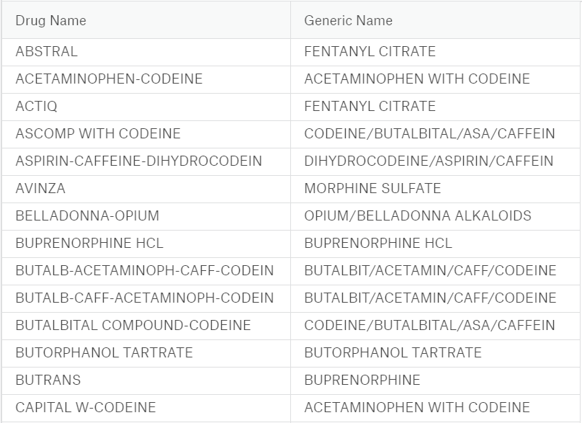
Sample Data:

Slide 4
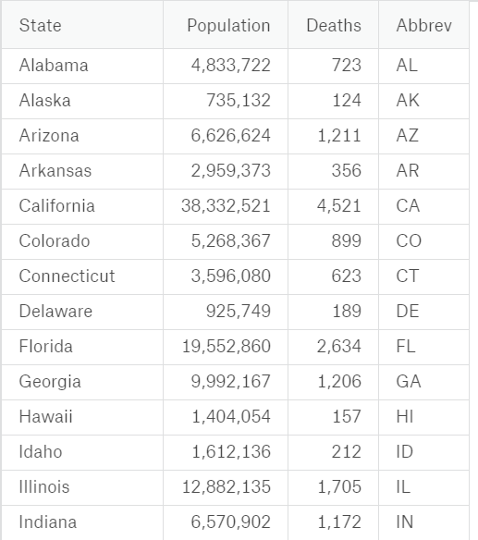
Death due to overdose

Slide 5
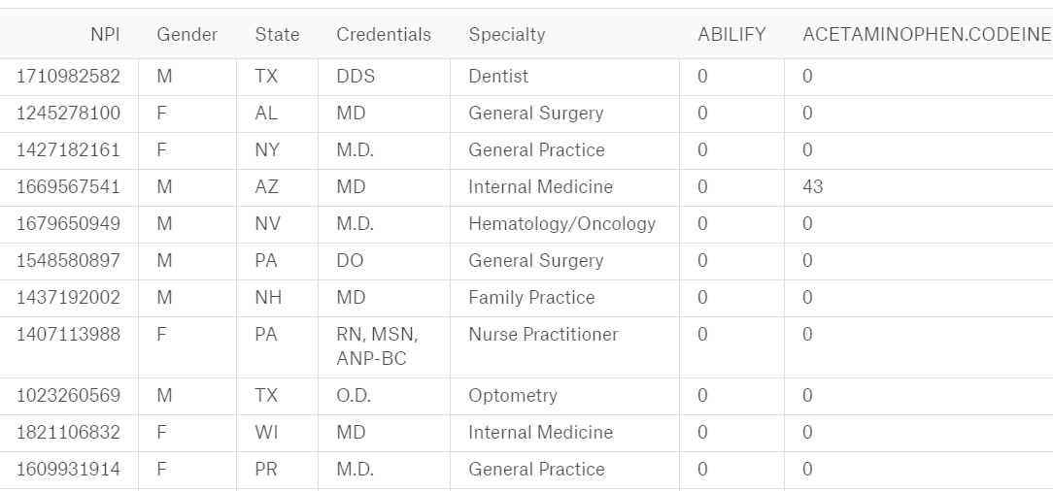
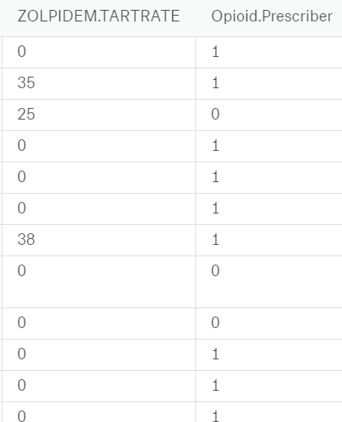
Prescription

Slide 6
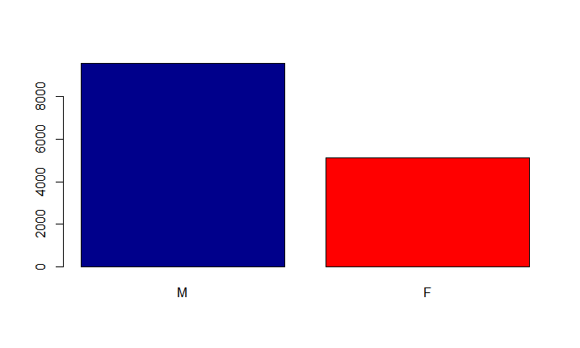

Exploratory Data Analysis
Is there any gender Gap.

Slide 7
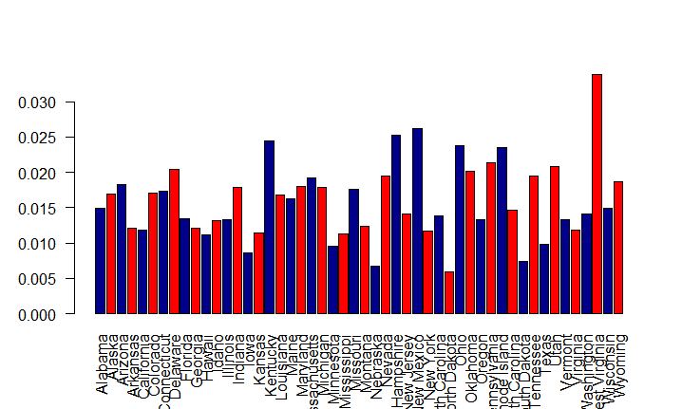
Which state is having more overdose prescriptions
West Virginia Had highest number of overdose prescriptions

Slide 8
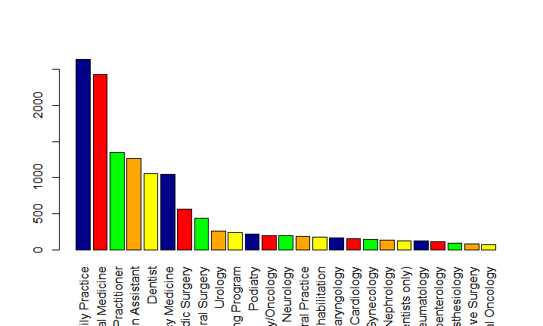
Is there any specialty which prescribes overdose.
Family Practice prescribes highest number of overdose prescriptions as compared to other specialties.

Slide 9
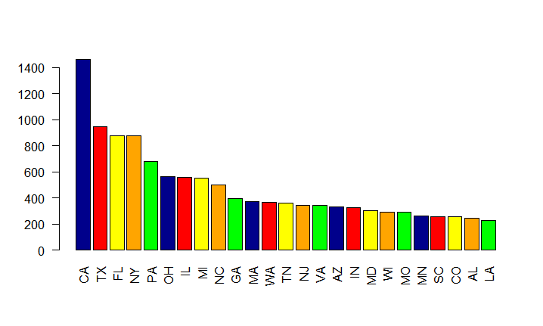
Which state is having more death ratio due to overdose
CA has Highest number of death due to drug overdose .

Slide 10
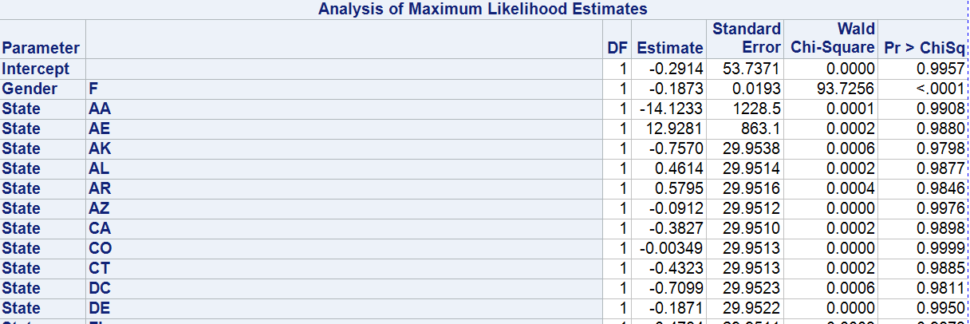
Logistic Model
Significant Variables: Gender ,State, Specialty
Target Variable: Opioid.Prescriber
Type 3 Analysis of Effects
Effect | DF | Wald Chi-Square | Pr > ChiSq
Gender | 1 | 25.8803 | <.0001
State | 54 | 140.9684 | <.0001
Specialty | 85 | 977.9372 | <.0001

Slide 11

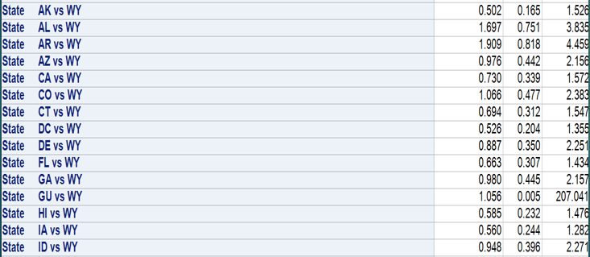
Odds Ratio Estimate Gender and State
Compared to males Females have 0.688 times odds of prescribing overdose drugs as compared to males.
Compared to WY state AK has 0.502 times odds of prescribing overdose drugs as compared to WY.

Slide 12
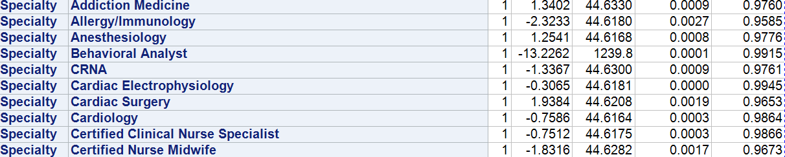
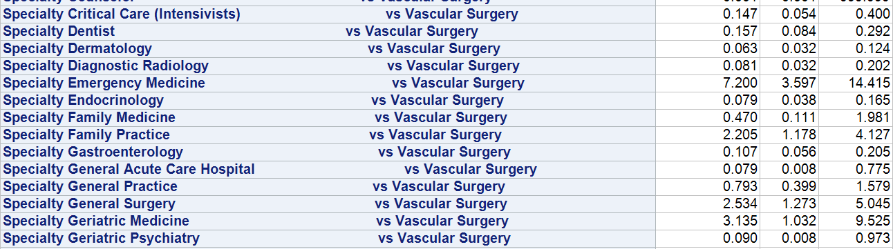
Odds Ratio Estimate contd.. Specialty
Compared to Vascular Surgery, Critical Care has 0.147 times odds of prescribing drug overdose as compared to Vascular Surgery.
Compared to Vascular Surgery, Dentist has 0.157 times odds of prescribing drug overdose as compared to Vascular Surgery
Compared to Vascular Surgery, Dermatology has 0.063 times odds of prescribing drug overdose as compared to Vascular Surgery.

Slide 13
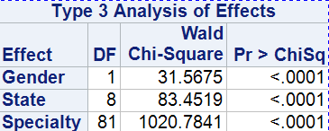
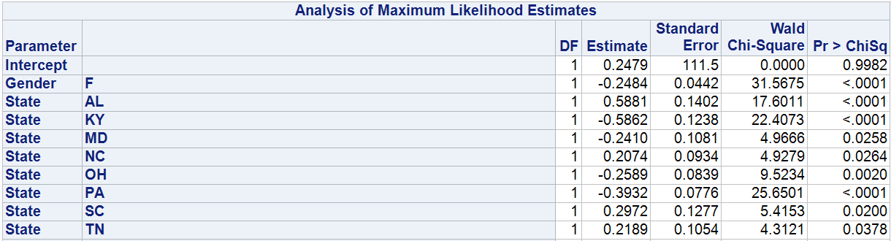
Odds Ratio Estimate-

Slide 14
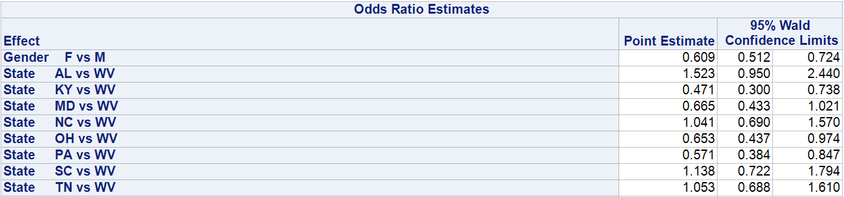
Odds Ratio Estimate contd…
The odds of drug overdose in KY is 0.471 times then in WV
The odds of drug overdose in PA is 0.571 times then in WV.

Slide 15
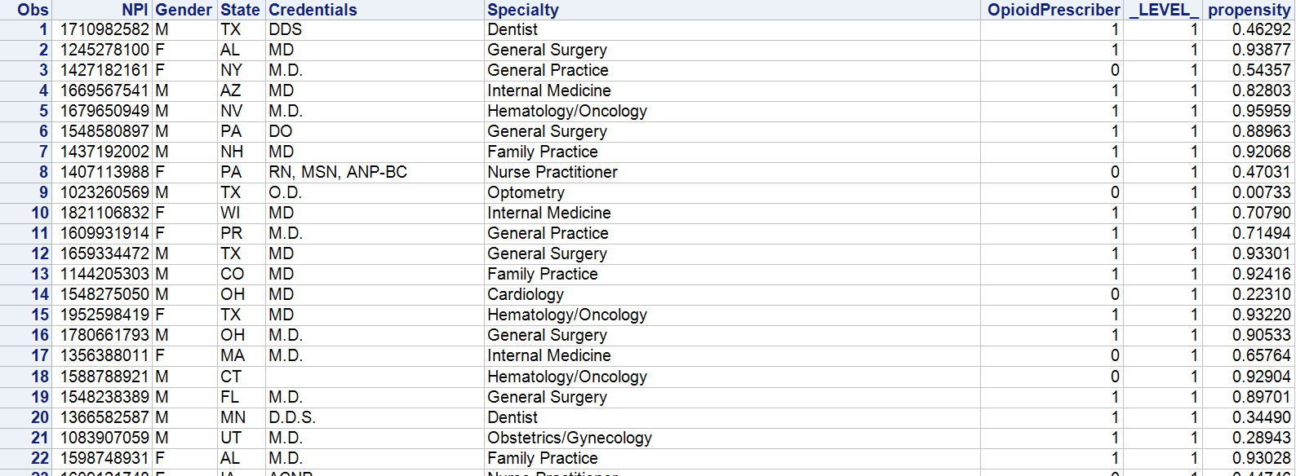
Propensity Score:
If gender is male, state is Texas, credentials is DDS and specialty is Dentist then the chances of having overdose prescription is 46%
If gender is female, state is Alabama, credentials is MD and specialty is General Surgery then the chances of having overdose prescription is 93%

Slide 16
Conclusion:
Females prescribe less overdose drugs as compared to males.
In Kentucky health care providers prescribe less overdose as compared to West Virginia.
In Pennsylvania health care providers prescribe less overdose as compared to West Virginia.

Slide 17
THANK YOU

